Slide 1

Docker – Domain 3 - Orchestration
Prepared by : Gowtham
670390

Slide 2
What is Container Orchestration ?
Container orchestration is all about managing the lifecycles of containers, especially in large, dynamic environments. Software teams use container orchestration to control and automate many tasks:
Provisioning and deployment of containers
Scaling up or removing containers to spread application load evenly
Movement of containers from one host to another if there is a shortage of resources in a host, or if a host dies
Allocation of resources between containers
External exposure of services running in a container with the outside world
Health monitoring of containers and hosts

Slide 3

Docker Swarm is native orchestration tool for Docker.
Standalone Containers vs Container as Swarm service
One of the key advantages of swarm services over standalone containers is that you can modify a service’s configuration, including the networks and volumes it is connected to, without the need to manually restart the service.
Docker will update the configuration, stop the service tasks with the out of date configuration, and create new ones matching the desired configuration.

Slide 4
A,B,C,D….. Of Docker Swarm
Nodes - an instance of the Docker engine participating in the swarm.
Manager node - The manager node dispatches units of work called tasks to worker nodes.
Worker Node - receive and execute tasks dispatched from manager nodes
Service is the definition of the tasks to execute on the manager or worker nodes. It is the central structure of the swarm system and the primary root of user interaction with the swarm.
Replicated services - the swarm manager distributes a specific number of replica tasks among the nodes based upon the scale you set in the desired state.
Global services – the swarm runs one task for the service on every available node in the cluster.

Slide 5
Feature Highlights of Swarm mode
Cluster management integrated with Docker Engine – Use Docker Engine CLI to create Swarm
Declarative service model – Various services in single Application stack (web front end + database backend)
Scaling – when scaled up/down, swarm manager automatically adapts by adding or removing tasks to maintain the desired state
Load balancing – Swarm lets you specify how to distribute service containers between nodes.
Secure by default - Each node in the swarm enforces TLS mutual authentication and encryption to secure communications between itself and all other nodes.
Rolling updates: At rollout time you can apply service updates to nodes incrementally. The swarm manager lets you control the delay between service deployment to different sets of nodes. If anything goes wrong, you can roll-back a task to a previous version of the service.

Slide 6
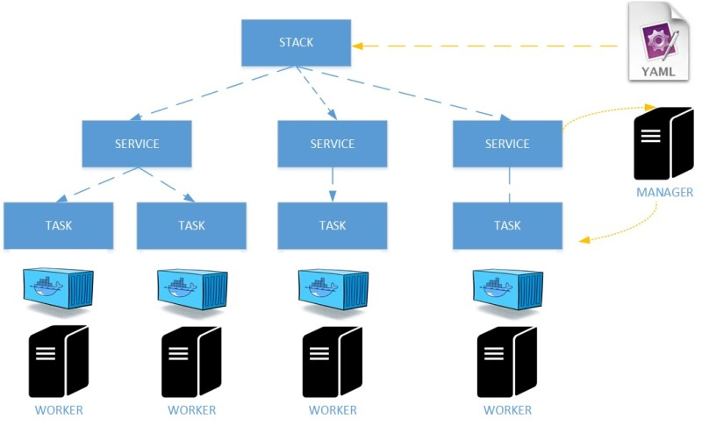
Docker Swarm Architecture

Slide 7
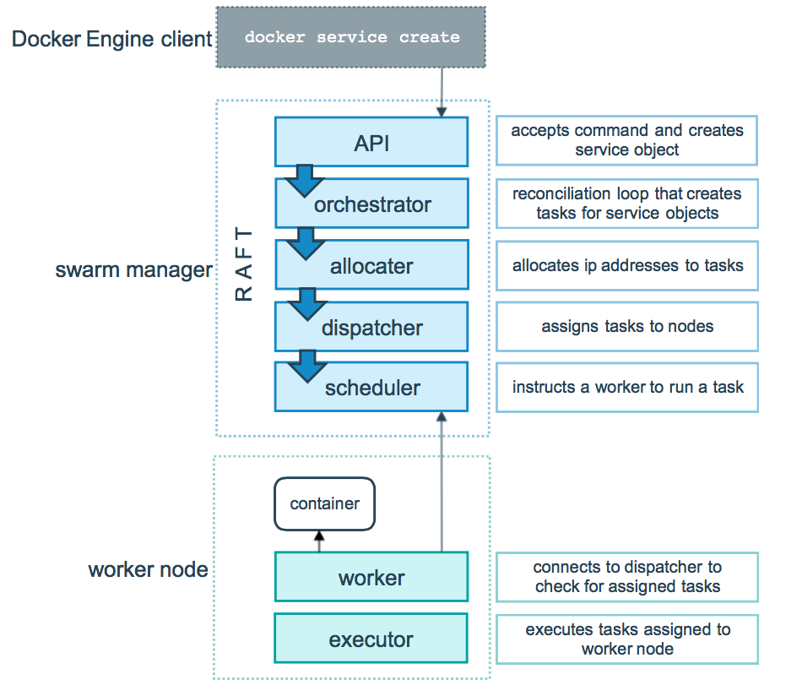
How services work ?

Slide 8
Create a Docker Swarm
Docker swarm init –
docker swarm init –advertis-addr <manager ip>
Add nodes as worker to swarm –
docker swarm join --token <token> <manager ip>:2377
(TCP port 2377. This port is used for communication between the nodes of a Docker Swarm or cluster. It only needs to be opened on manager nodes.)
Verify node list –
docker node ls (from manager node)

Slide 9
Deploy a service to swarm
Create a service –
docker service create –replicas 1 --name <service name> <image name>
List running services –
docker service ls
Inspect a service on swarm –
docker service inspect --pretty <service name>
Which nodes are running the service –
docker service ps <service name>

Slide 10
Docker Compose
Create docker-compose.yml file with configurations–
Deploy services from yaml–
docker-compose up (from the location of yaml)
docker-compose ps
docker-compose images
To stop services –
docker-compose down

Slide 11
References
docs.docker.com
play-with-docker.com
Docker compose project (github repo)-
https://github.com/gowtham495/docker-demo.git

Slide 12


